Slide 1
Spotify
Track Explorer
ML-Powered Music Recommendation System
-by Karthika Manoj

Slide 2
Table of Contents
01. Title Text Here
02. Title Text Here
03. Title Text Here
04. Title Text Here
05. Title Text Here
06. Title Text Here
07. Title Text Here
08. Title Text Here
09. Title Text Here

Slide 3
“Music gives a soul to the universe, wings to the mind, flight to the imagination, and life to everything.”
— Plato

Slide 4

What is Track Explorer?
A music recommendation system built using machine learning.
Suggests similar songs and genres based on Spotify audio features.
Combines cloud data, predictive modeling, and UI design.
Play
Shuffle

Slide 5
Powered by Cloud + ML Tools
#
Tech Stack
1
Power BI: Initial analysis and transformation
09:00 AM
2
Databricks: Data engineering & EDA
10:00 AM
3
SageMaker: ML model training & deployment
11:00 AM
4
Streamlit: Interactive user interface (planned)
12:00 PM
5
Spotify API: (Planned for real-time metadata and previews)
01:00 PM
6
Snowflake: Data warehousing
02:00 PM

Slide 6
Size & Scope
Dataset Overview
~114,000 tracks
This project uses a public dataset of Spotify tracks sourced from Kaggle. It contains over 100K songs from 125+ genres with detailed audio features extracted via the Spotify API. The dataset is ideal for music analysis, genre classification, and building recommendation systems.
Source
Sourced from Kaggle – Spotify Tracks Dataset
Feature Highlights
Includes valence, energy, danceability, tempo, and more

Slide 7
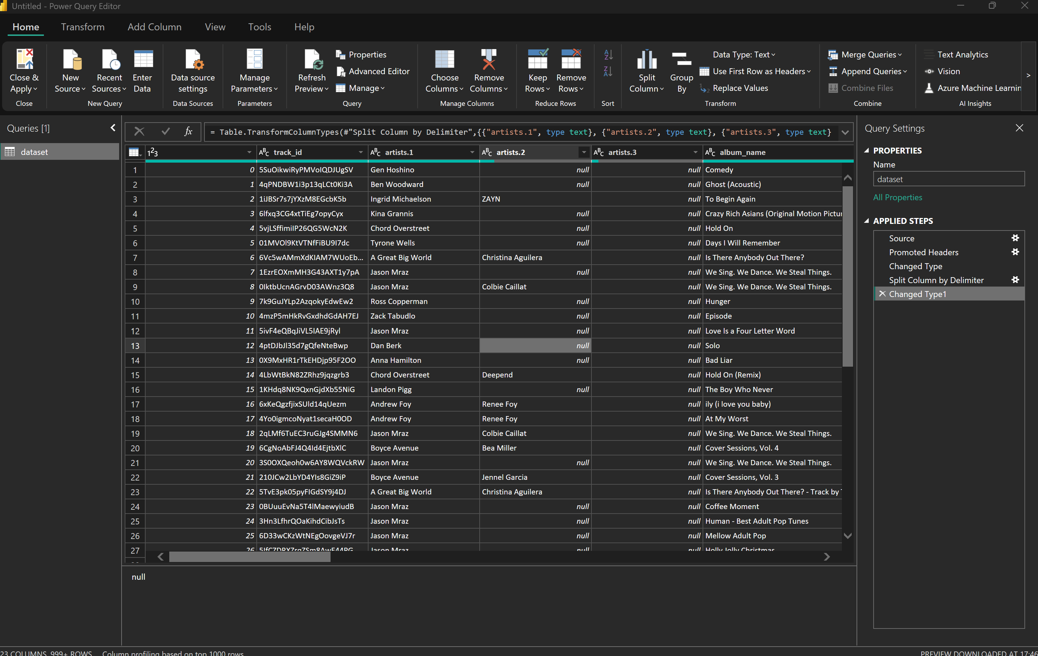
PowerBI: Data Transformation using PowerQuery
Split the ‘artists’ Column – incase of more than 1 artist, artist column is siplit into different columns based on the delimiter ( in this case a semicolon)

Slide 8
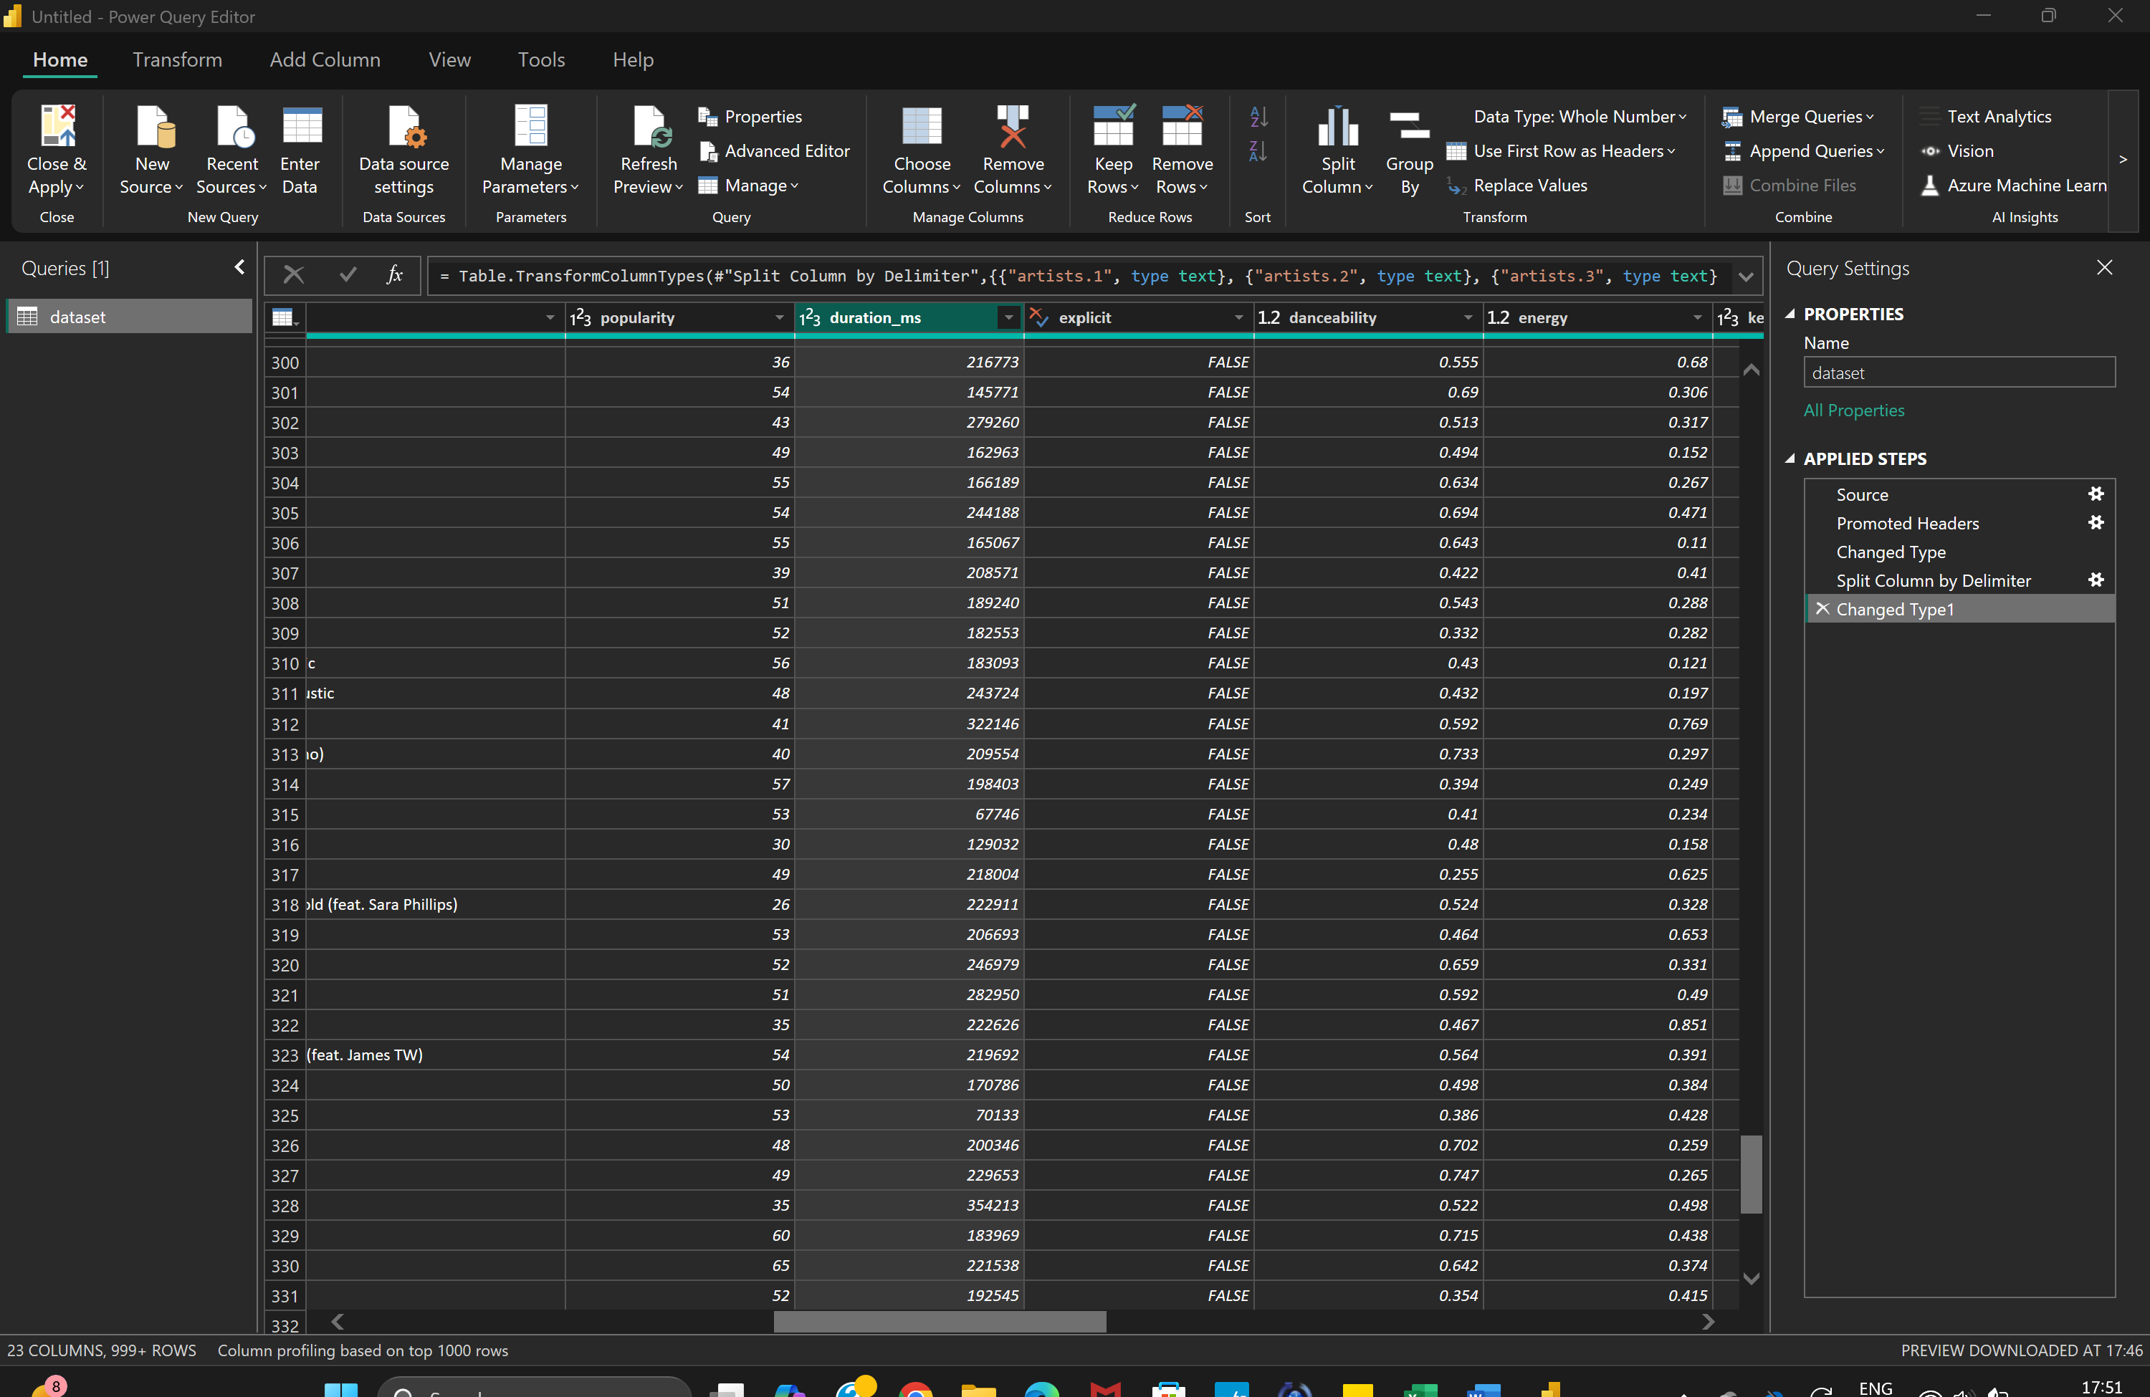
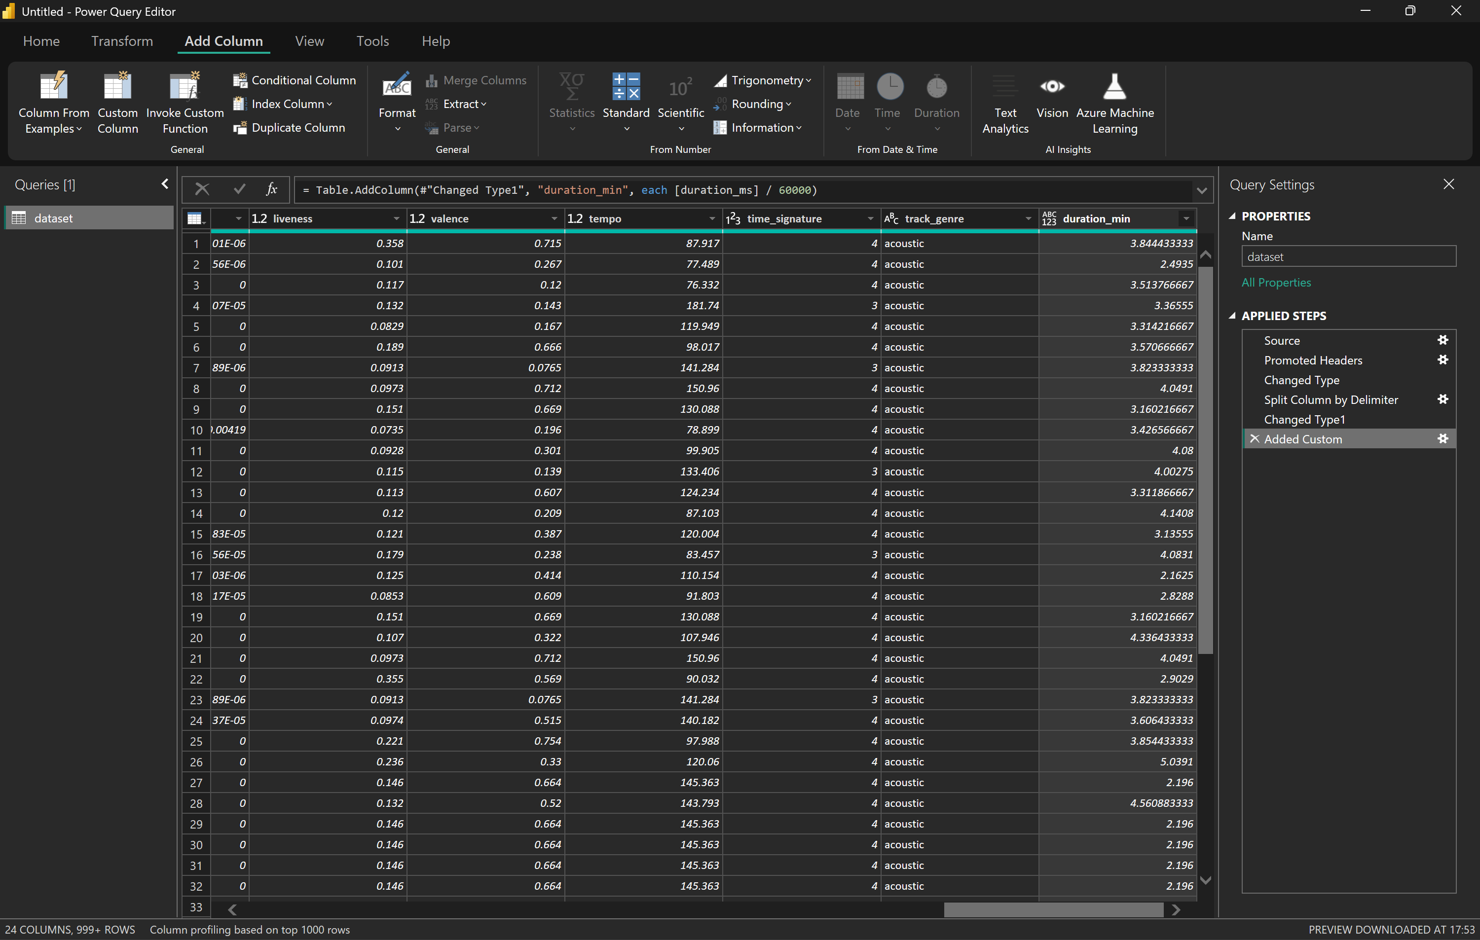
to convert duration_ms to minutes:
PowerBI: Data Transformation using PowerQuery
2. Add New Columns - to convert durationms into minutes

Slide 9
to convert duration_ms to minutes:
PowerBI: DAX
Use Case | Formula Example | What It Does
Total tracks | TotalTracks = COUNT('Spotify'[track_id]) | Counts the number of tracks
Average popularity | AvgPopularity = AVERAGE('Spotify'[popularity]) | Gives average popularity score
Total duration (minutes) | TotalDuration = SUM('Spotify'[duration_ms]) / 60000 | Total duration of all tracks in minutes
Count explicit tracks | ExplicitCount = CALCULATE(COUNT('Spotify'[track_id]), 'Spotify'[explicit] = TRUE()) | Counts tracks marked explicit
Average danceability by genre | AvgDanceability = AVERAGE('Spotify'[danceability]) | Averages danceability (you can use this in visuals by genre)

Slide 10
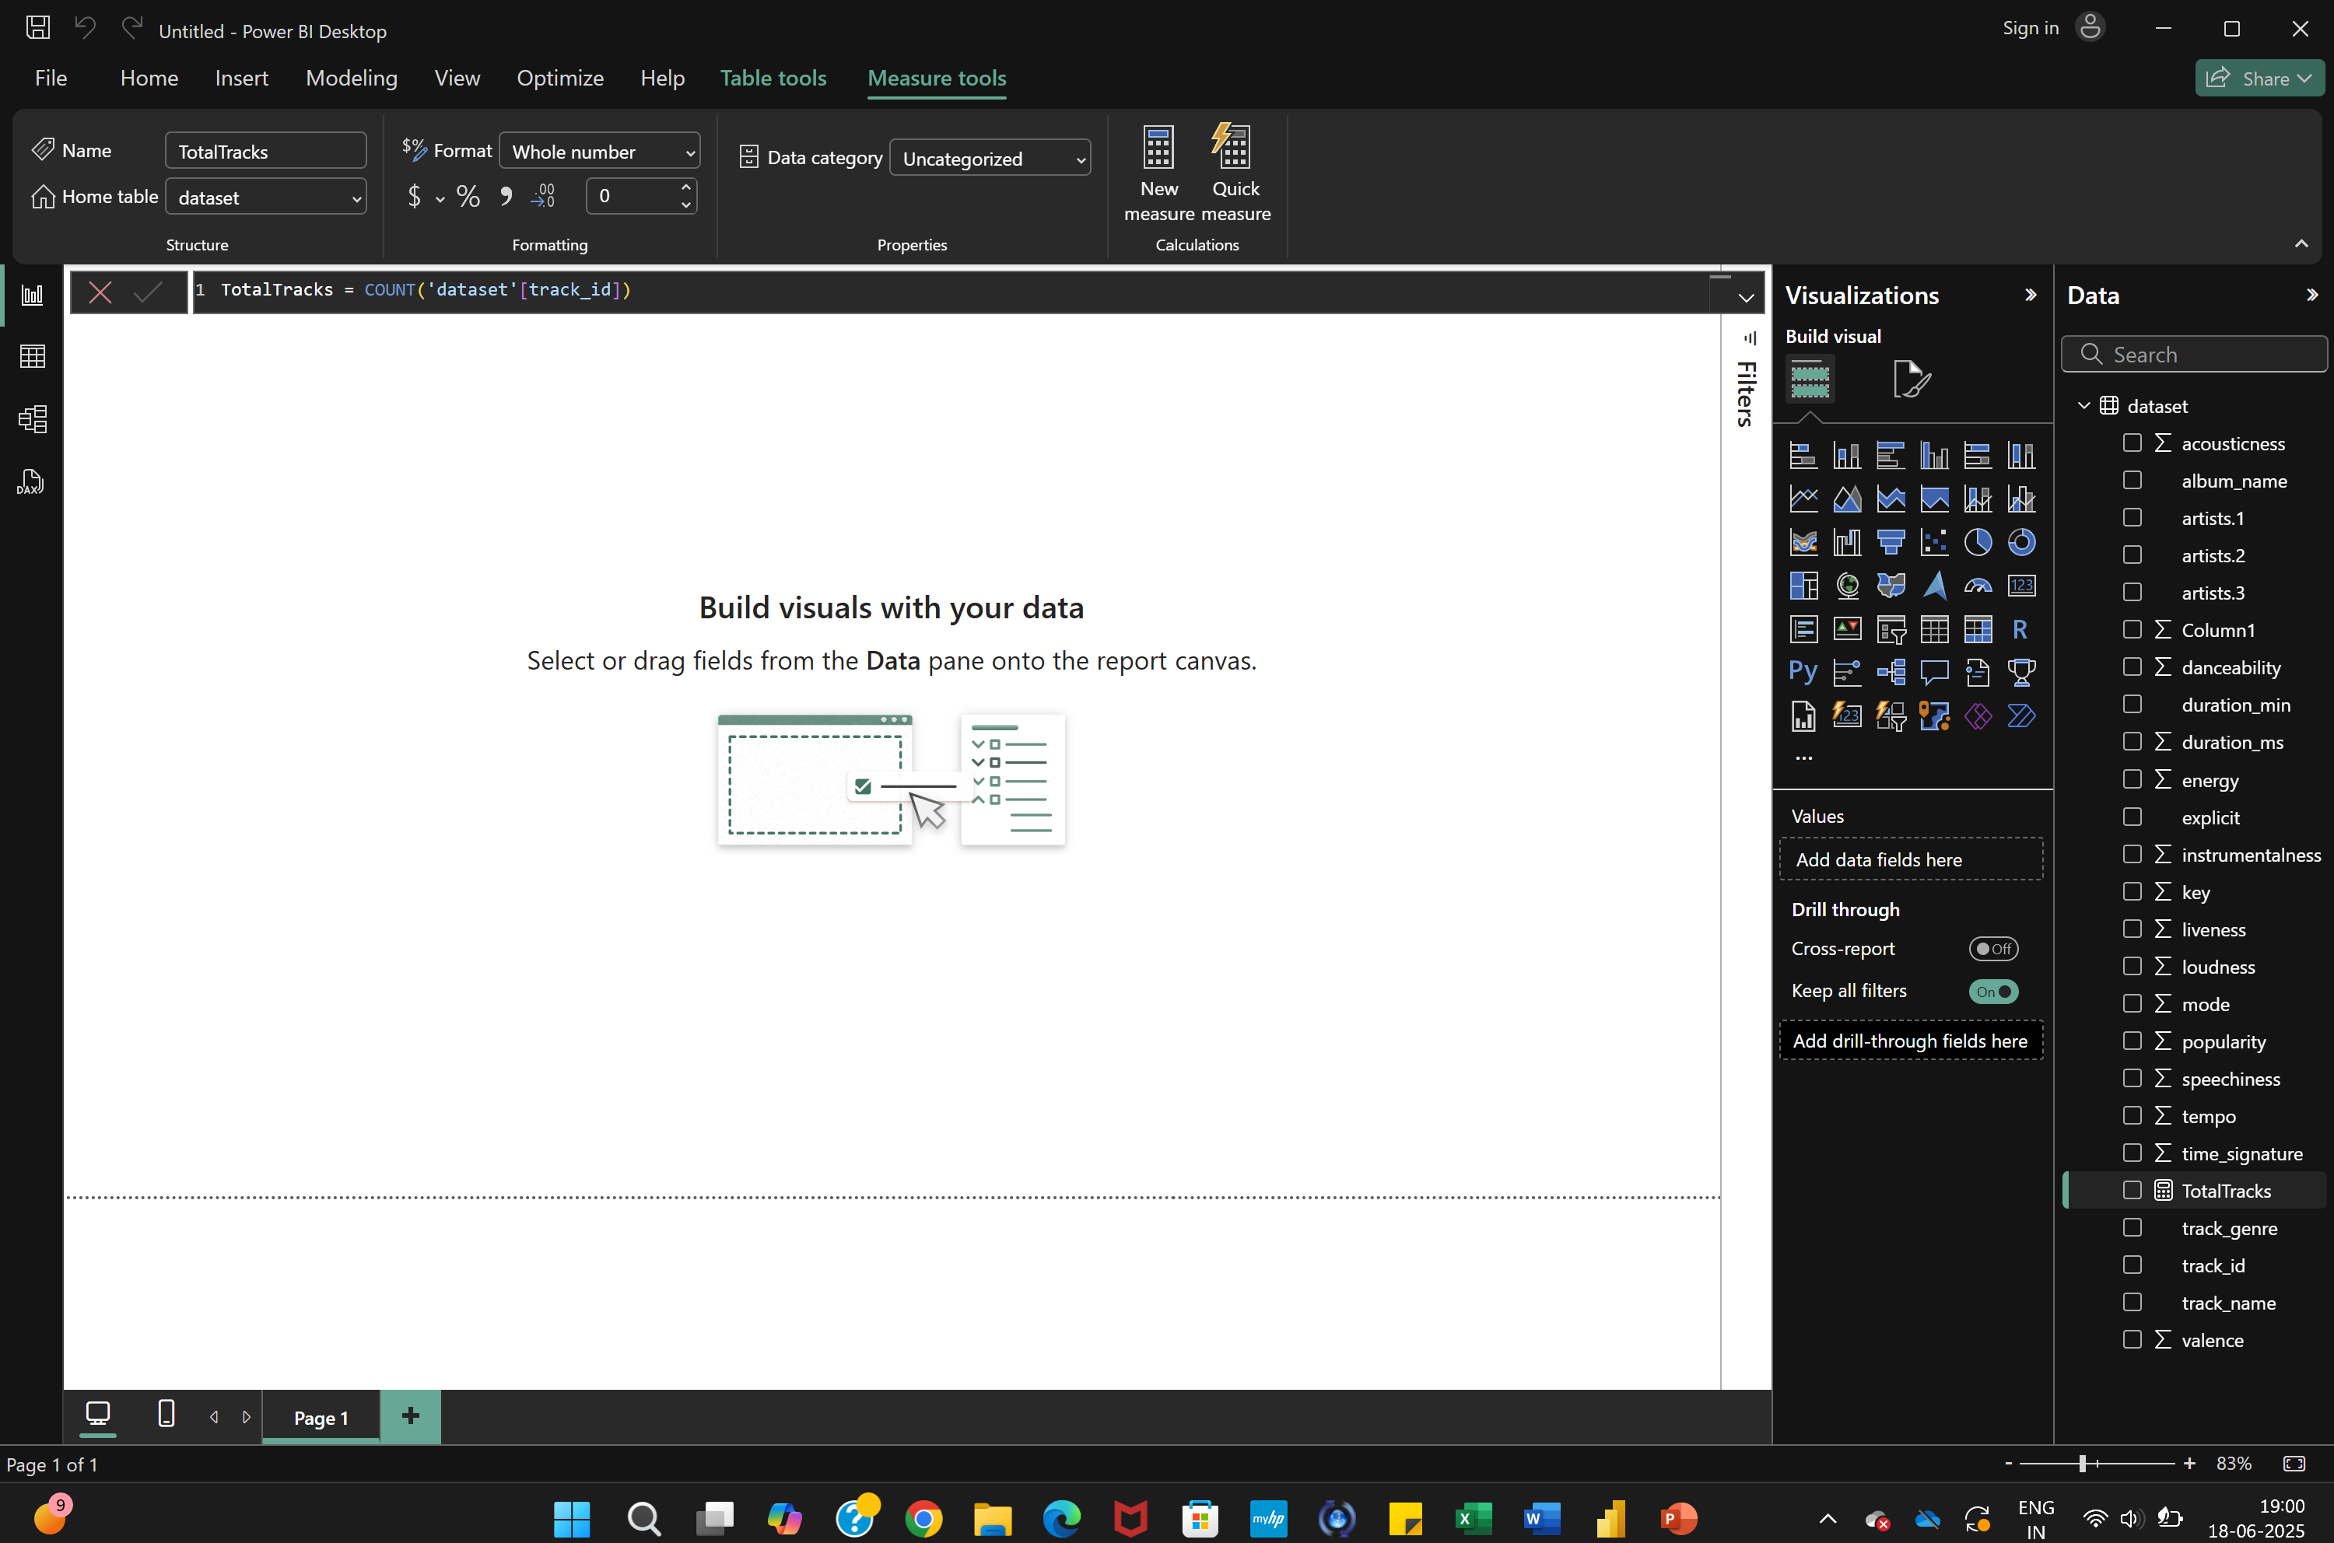
to convert duration_ms to minutes:
PowerBI: DAX
Count the total number of tracks in the dataset
TotalTracks = COUNT('dataset'[track_id])

Slide 11
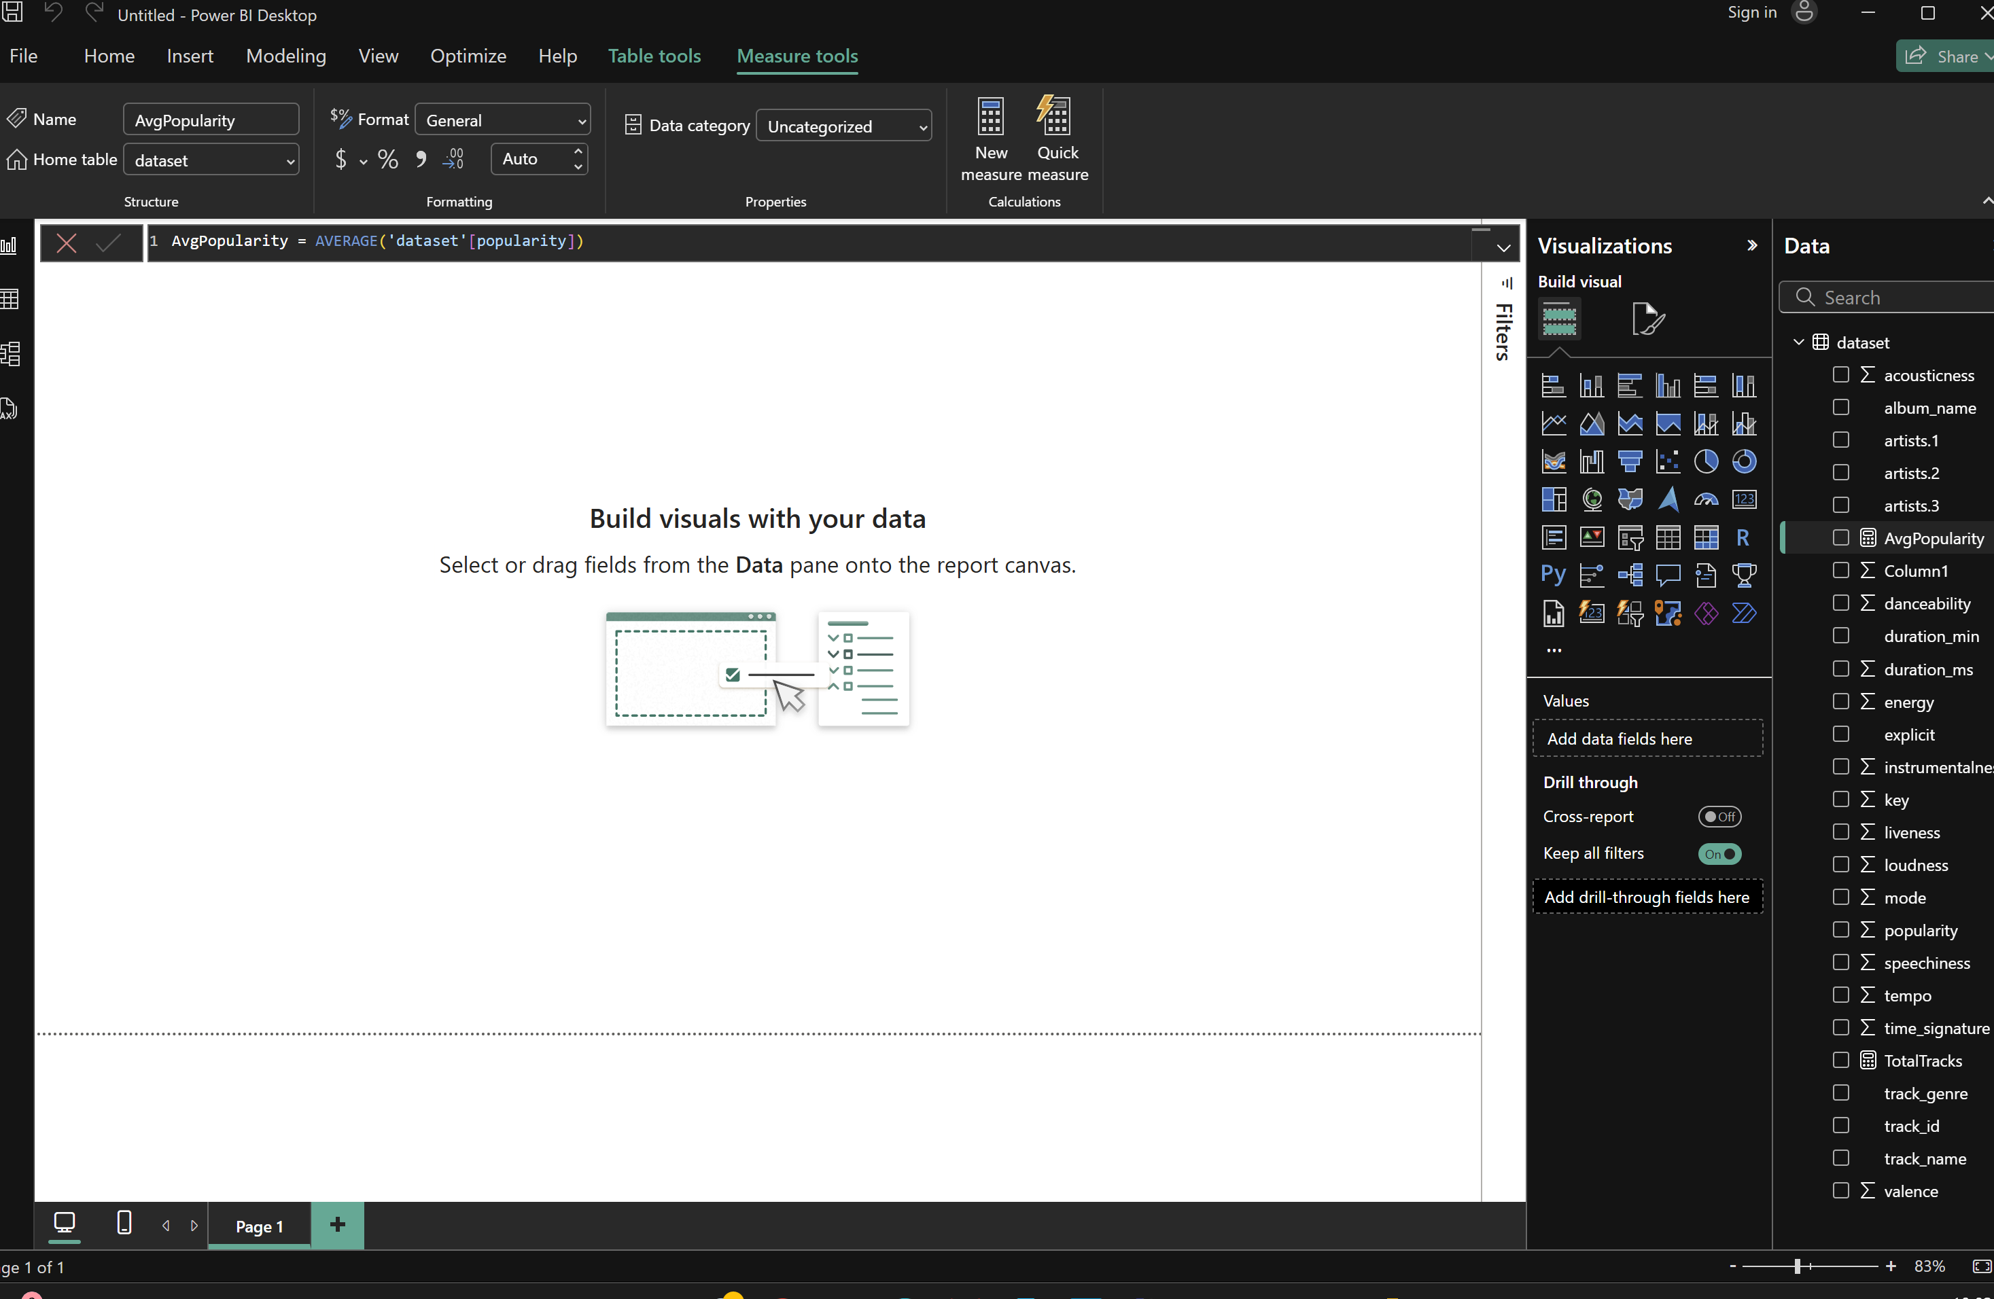
to convert duration_ms to minutes:
PowerBI: DAX
Calculate the average popularity score
AvgPopularity = AVERAGE('Spotify'[popularity])

Slide 12
to convert duration_ms to minutes:
PowerBI: DAX
Calculate the average popularity score
AvgPopularity = AVERAGE('Spotify'[popularity])

Slide 13
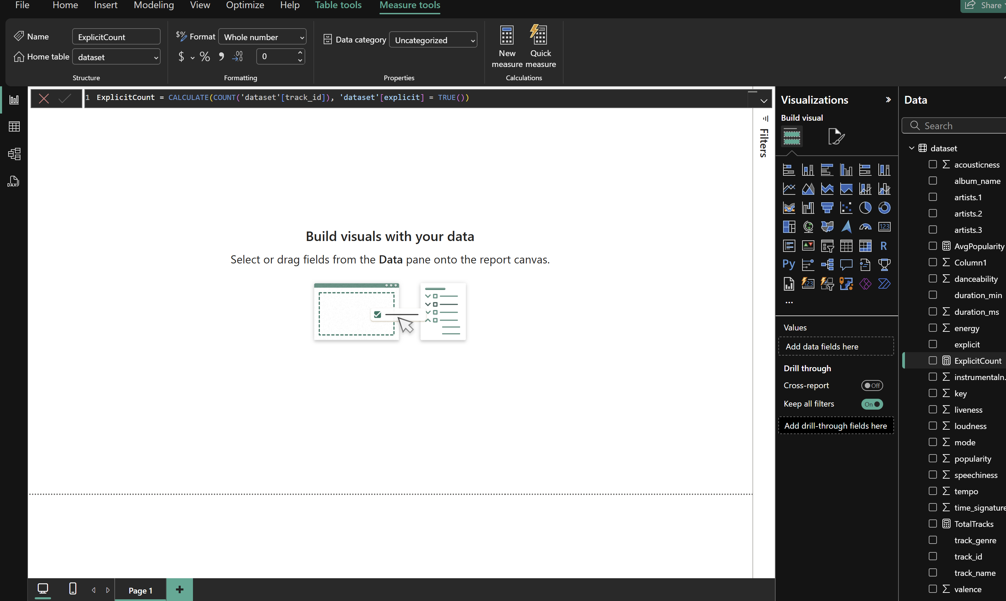
to convert duration_ms to minutes:
PowerBI: DAX
Count how many tracks are marked as explicit
ExplicitCount = CALCULATE(COUNT('Spotify'[track_id]), 'Spotify'[explicit] = TRUE())

Slide 14

to convert duration_ms to minutes:
Summary: Power Query vs DAX
Feature | Power Query | DAX
Type | Adds a column | Creates a measure
When it runs | Before data is loaded | After data is loaded
Static or dynamic | Static | Dynamic (reacts to slicers/filters)
Best for | Preprocessing values | KPIs, insights, context-aware logic

Slide 15
to convert duration_ms to minutes:
Which should you use?
Goal | Use
You want a reusable column like duration_minutes | Power Query
You want to show total minutes listened (KPI) | DAX
You want dynamic calculations based on genre/artist | DAX
You want to keep your model smaller (no extra column) | DAX

Slide 16
Work in-progress

Slide 17
Thanks !

Slide 18

ATTRIBUTION
This presentation template was created by SlideKit
Please keep this slide for attribution.

